Slide 1
Bird call classification: The Challenge
Dominik Siric

Slide 2
How was the training and testing performed
For each of our submissions data was pre-processed in different ways
This will be explained for all submissions respectively later
The pre-processing, this time, was done on normalized data, instead of standardized data we used for the previous task
After the data was pre-processed for training, we combined the arrays and randomly shuffled it, just like in the previous task, to ensure better learning
Then a certain learning algorithm was performed on the training data using 5 fold cross-validation
The details of these algorithms will also be explained for each of our submissions

Slide 3
First submission
Money saved – 164
For the first submission we used the same data we pre-processed in the last task
So the training data was reduced with PCA preserving 99% of variance
Test data – using the same data reduction as for the training data so as also reduced the data with PCA
Model – From the last task the algorithm that produced the best results was the Support Vector Classification so we also used that classifier for this submission with default parameters to start
The problem with this algorithm was probably that when we reduced the data with 99% variance the test data wasn’t reduced to the same features and the same number of features as the test data – that could be the reason why the score was low
We now try to do better data dimensionality reduction and get better results

Slide 4
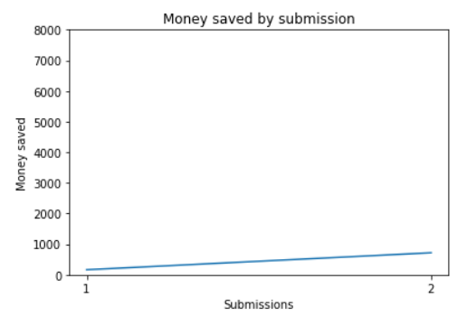
Second submission
Money saved – 718
This time, instead of normal PCA, we used kernel PCA for dimensionality reduction while keeping 50 most important features
This was done for both the test and training sets
Everything else was done the same way as in the first submission, so once again the learning algorithm was SVC with default parameters
Upon more detailed examination of the prediction csv file, we noticed that it was predominantly filled with 6s thus the score was quite low but still better than the previous one
There could have been a problem once again with the dimensionality reduction but this time with kernel PCA

Slide 5
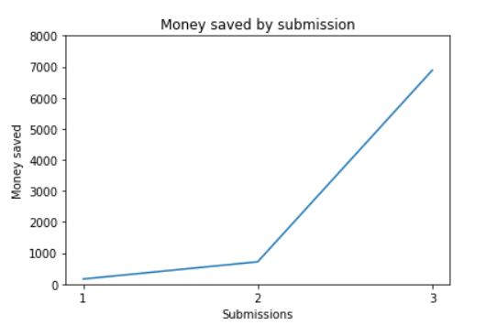
Third submission
Money saved – 6885
Finally the result seemed to improve drastically
To get this results we ditched the kernel PCA from the previous model and went back to the standard PCA
We combined the feature arrays and reduced the dimensionality to 20 most informative features using the PCA
Sama data augmentation was done to the test set
Again, the model was SVC with default parameters

Slide 6
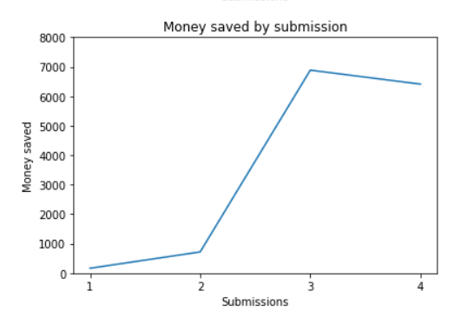
Fourth submission
Money saved – 6411
Regarding the features everything was the same as the previous submission, so the 20 most important features by PCA
In this algorithm we added an evaluation set to test different parameters using randomized search and get the best ones for the SVC model
For this to work in a reasonable amount of time we had to reduce the number of rows from the training data, thus we kept 2000 random rows from each class
This is where the problem arose since we randomly kept 2000 rows we didn’t take into account that the labels should be evenly distributed among those rows
That is probably the reason for the lower score than before even though we tried to find the best parameters with randomized search
This is what we fixed in the next submission

Slide 7
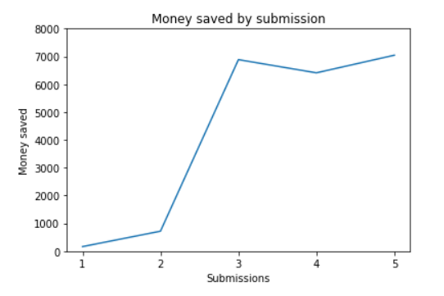
Fifth submission
Money saved – 7044
Essentially this submission was fixing the mistakes from the previous one, so again using the 20 features arrays
This time we kept 5000 rows from each of the 6 training arrays and we made sure that the number of occurrences of 0s and nonzero (labels) was roughly the same so that we get more meaningful training results
For example, this would mean that if in the file ‘tawowl.npy’ there are 2200 occurrences where the bird was heard me made sure to keep all of those and to keep the other 2800 rows where the bird wasn’t heard to that it adds up to 5000 and we still have a good representation. If there were more than 2500 occurrences where the specific bird was heard then the split was the same so 2500/2500 for rows with 0s and nonzero and so on…
For finding the best parameters this time we used grid search to hopefully get more precise result for better parameters
These are the parameters we got after the grid search: best_params = {'C': 10, 'coef0': 0.0, 'degree': 2, 'gamma': 1, 'kernel': 'rbf'}
After finding these parameters we tested the model and got the 7044 points

Slide 8
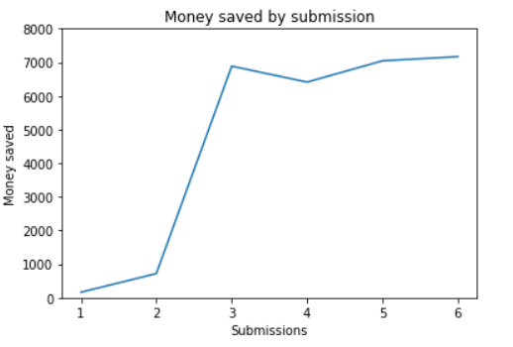
Sixth submission
Money saved – 7168
Using the same data processing as in the previous submission but this time we used the Gradient Boosting classifier algorithm with default parameters
The result showed that the previous data processing was proving to get decent results and now we try to improve this GBC model since it seems to get better results than the previous SVC model

Slide 9
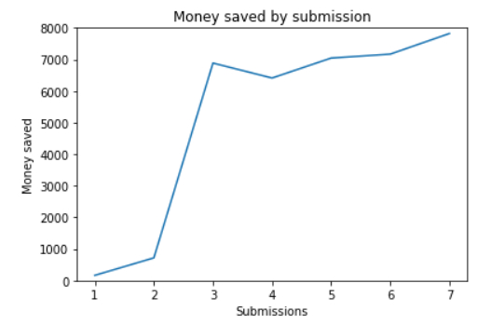
Seventh submission
Money saved – 7820
The training was done in the same way as the previous submission but this time we kept 10000 rows of each training array for each species
In addition to that, we decided to keep more 100 most important features using PCA rather than the 20 we used for previous classifications

Slide 10
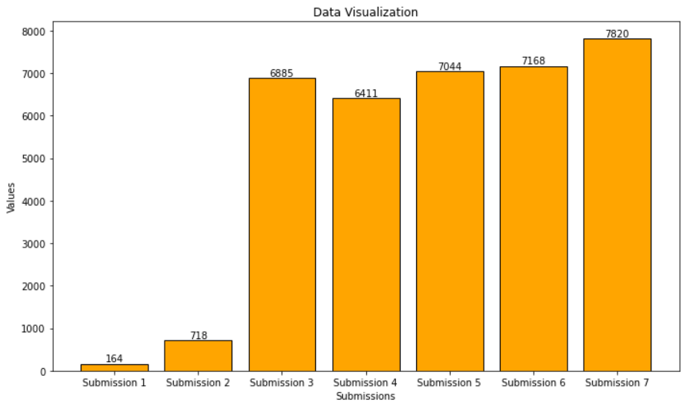
Final comparison of submissions

